Slide 1
GraphEditor Introduction
PhUSE CSS 2019

Slide 2
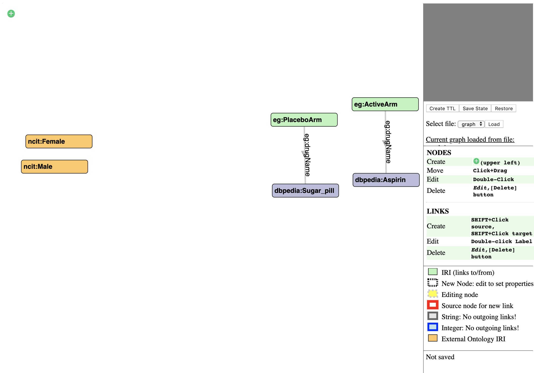
User interface – Start view

Slide 3
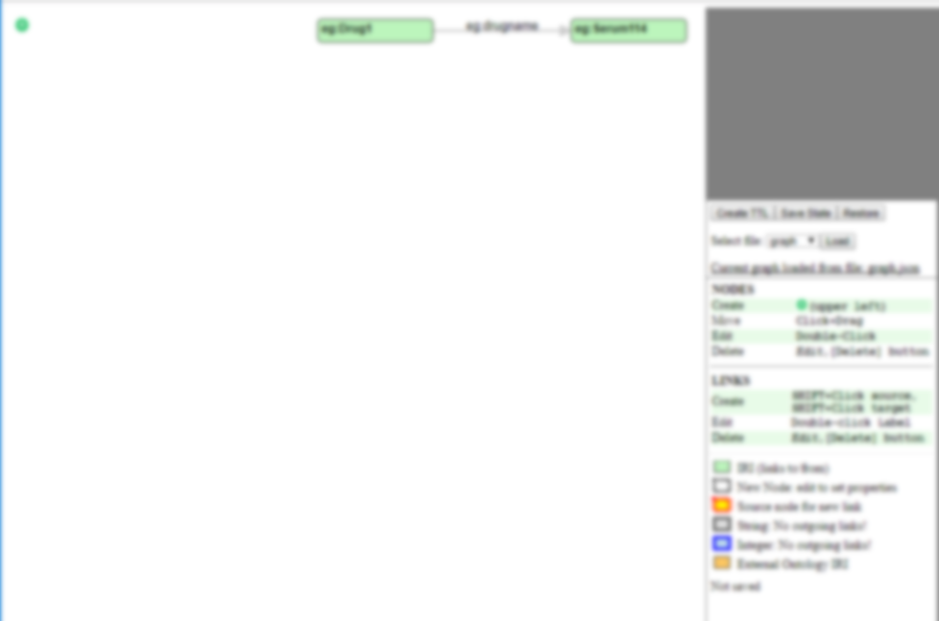
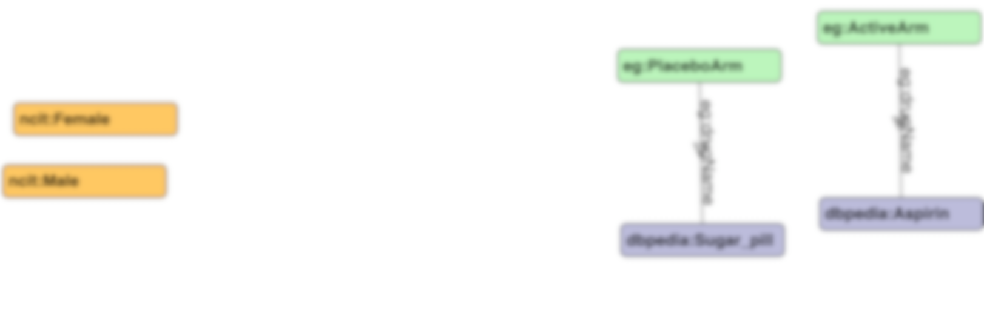
User interface – Start view
Whiteboard area
Edit area
Only shown when
node/edge is in
edit mode
Whiteboard
Save/Load/Export
Action Help
Legend
Save status

Slide 4
Functions
Nodes
Add node
Edit node
Delete node
Links
Create link
Edit link
Reverse link direction
Save/Load/Export the graph
Save as file (JSON and TTL)
Save current state
Restore
Load pre-configured graph

Slide 5

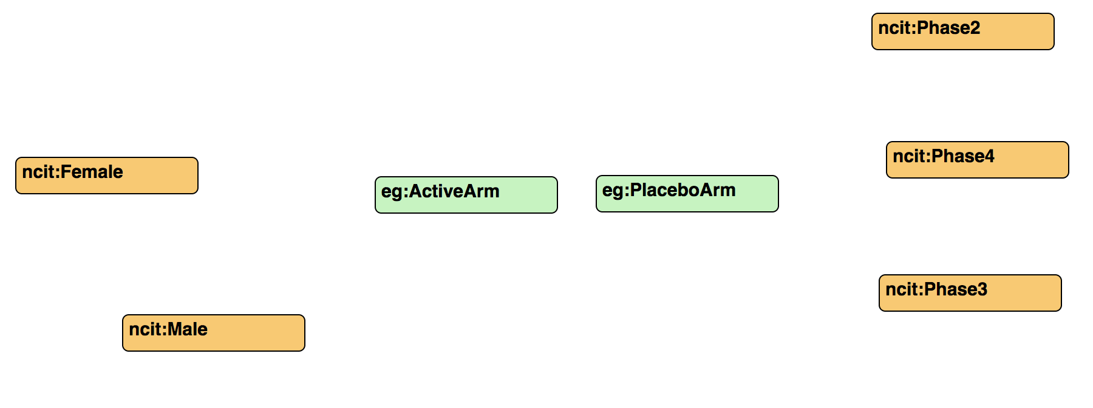
Add node
1. Click in upper left corner
2. A new node is created on the whiteboard
Click

Slide 6
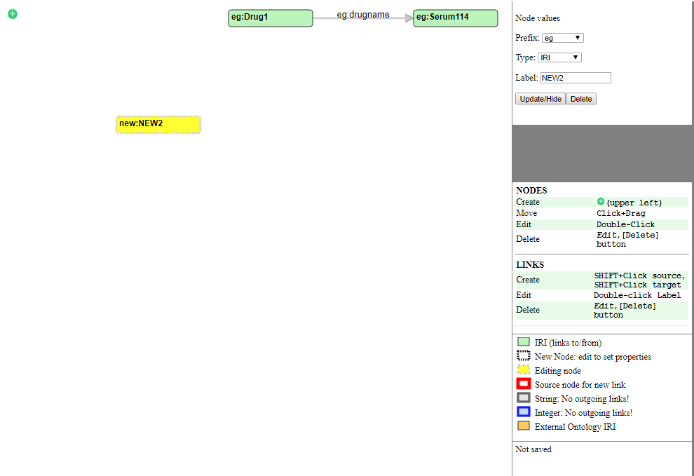


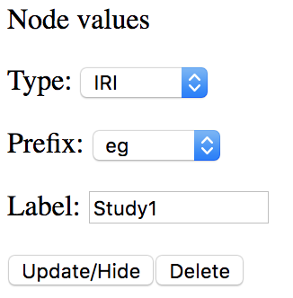
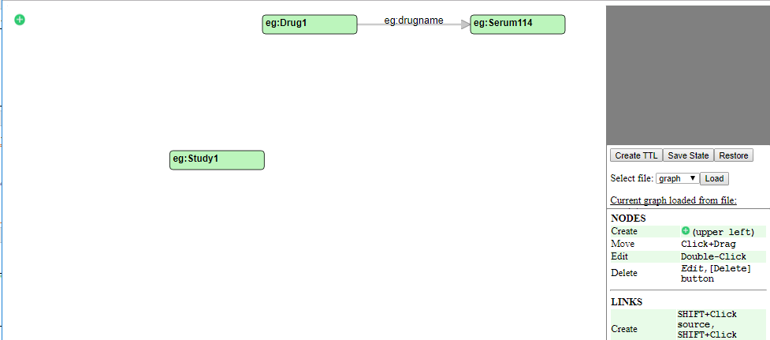

Edit node
1. Double click a node to get into edit mode
2. Node is highlighted and the edit area is displayed
Double-Click
4. Node prefix and label is updated
3. In edit area:
Select Type
Select Prefix
Type in Label
Click Update/Hide to save changes

Slide 7
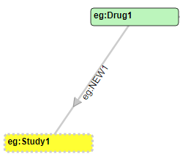
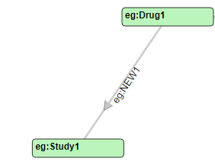
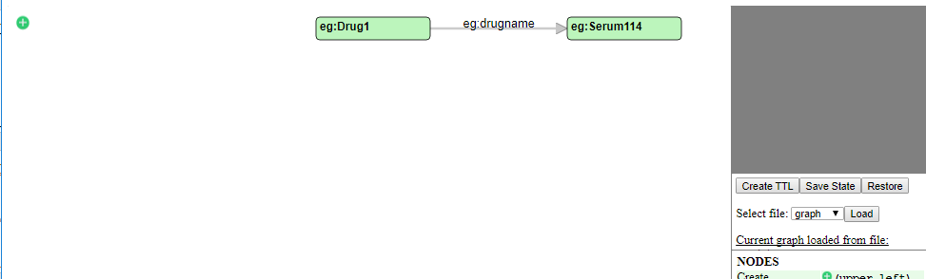
Delete node
1. Double click a node to get into edit mode
2. Node is highlighted and the edit area is displayed
Double-Click
3. Click Delete
3. The node and any attached links are removed

Slide 8
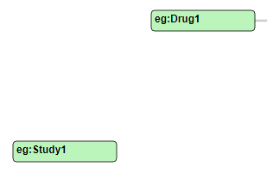

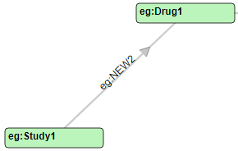
Create link
1. Shift+click a node to select it as source of link
2. Node is highlighted
Shift-Click
3. Shift click the target link
4. A new link is created
Shift-Click

Slide 9
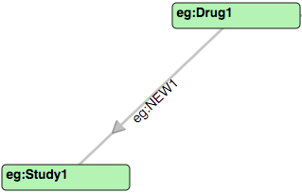
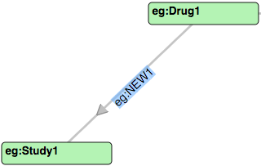
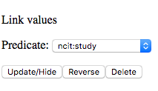
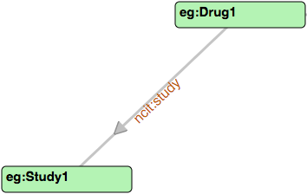
Edit link
1. Double click a link to get into edit mode
2. Edge label is highlighted and the edit area is displayed
Double-Click
4. Node predicate is updated
3. In edit area:
Select a Predicate in the dropdown list
Click Update/Hide to save changes

Slide 10
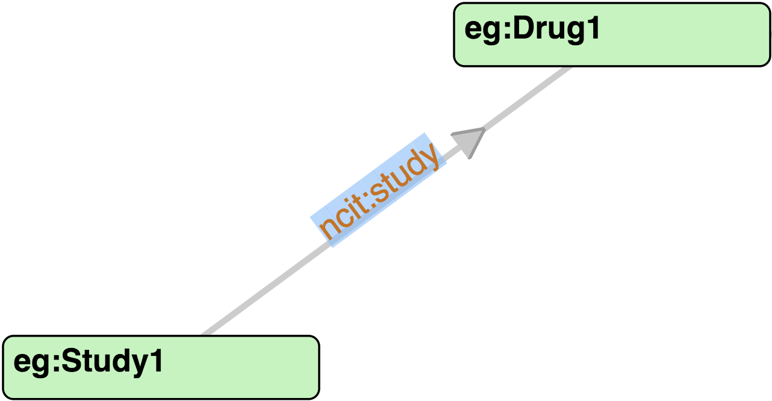
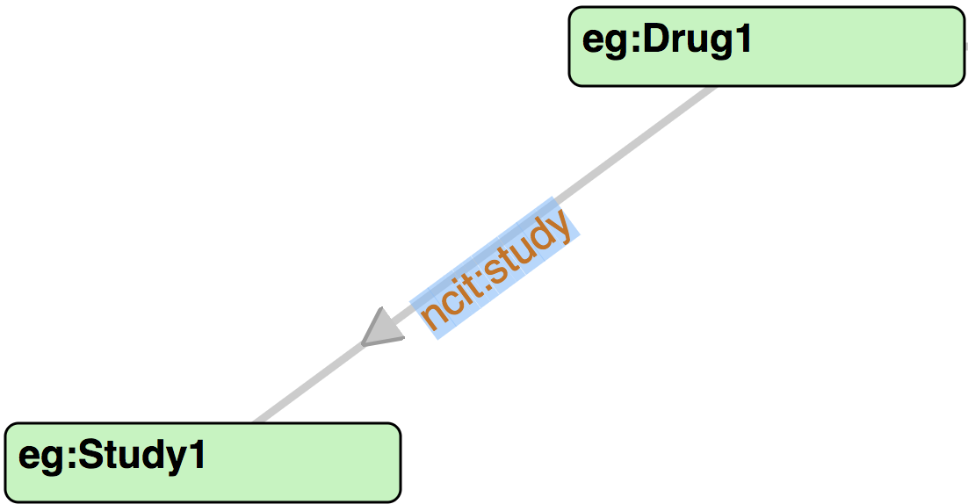
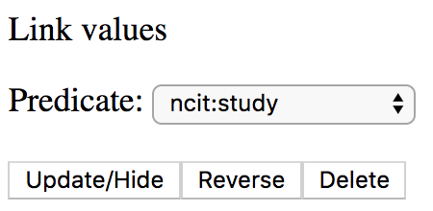


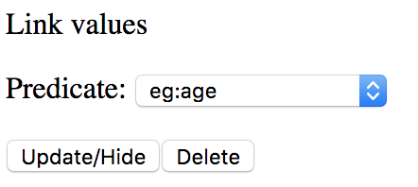
Edit link – reverse link direction
1. If a link is between two IRI’s, the direction can be reveresed
Wrong: Study1 has study Drug1
Correct: Drug1 has study Study1
2. Links between an IRI node and String/Integer node cannot be reversed

Slide 11

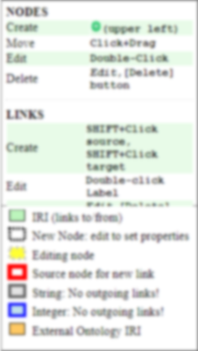

Save/Load/Export the graph
Saves the current graph as JSON and TTL files to the download directory
Saves the current graph to the web browsers local memory. It retains in memory until Save state is clicked again.
Restores the graph from the last saved state
Loads the selected graph from pre-configured graphs
Indicates the source of the current graph
Indicates when the graph was last saved with Save state

